Slide 1

Course Title: Computer Organization and Architecture
Course Code : CSE322
Name : Thanjida Akhter
ID : 102-15-1030

Slide 2
TOPIC
1.Instruction execution characteristics.
2. The use of a large register file.

Slide 3
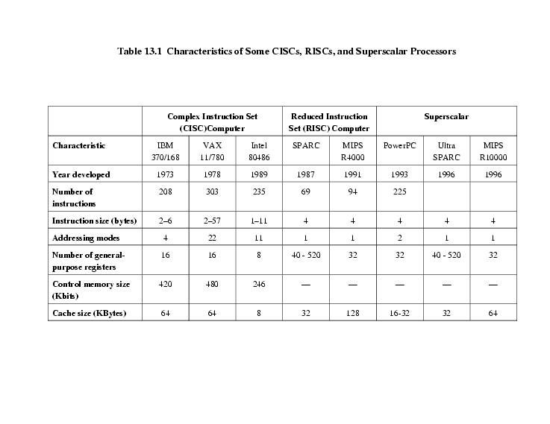
Comparison of processors

Slide 4
Execution Characteristics
Operations performed
Operands used
Execution sequencing

Slide 5
Weighted Relative Dynamic Frequency of HLL Operations
Dynamic Occurrence
Machine-Instruction Weighted
Memory-Reference Weighted
Pascal
C
Pascal
C
Pascal
C
ASSIGN
45%
38%
13%
13%
14%
15%
LOOP
5%
3%
42%
32%
33%
26%
CALL
15%
12%
31%
33%
44%
45%
IF
29%
43%
11%
21%
7%
13%
GOTO
—
3%
—
—
—
—
OTHER
6%
1%
3%
1%
2%
1%

Slide 6
Dynamic Percentage of Operands
Pascal
C
Average
Integer Constant
16%
23%
20%
Scalar Variable
58%
53%
55%
Array/Structure
26%
24%
25%

Slide 7
Procedure Calls
Very time consuming
Depends on number of parameters passed
Depends on level of nesting
Most programs do not do a lot of calls followed by lots of returns
Most variables are local

Slide 8
Large Register File
Software solution
Require compiler to allocate registers
Allocate based on most used variables in a given time
Requires sophisticated program analysis
Hardware solution
Have more registers
Thus more variables will be in registers

Slide 9
Registers for Local Variables
Store local scalar variables in registers
Reduces memory access
Every procedure (function) call changes locality
Parameters must be passed
Results must be returned
Variables from calling programs must be restored

Slide 10
Register Windows
Only few parameters
Limited range of depth of call
Use multiple small sets of registers
Calls switch to a different set of registers
Returns switch back to a previously used set of registers

Slide 11
Register Windows cont.
Three areas within a register set
Parameter registers
Local registers
Temporary registers
Temporary registers from one set overlap parameter registers from the next
This allows parameter passing without moving data

Slide 12
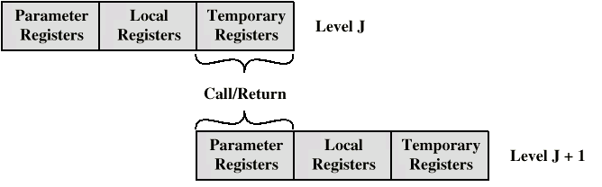
Overlapping Register Windows

Slide 13
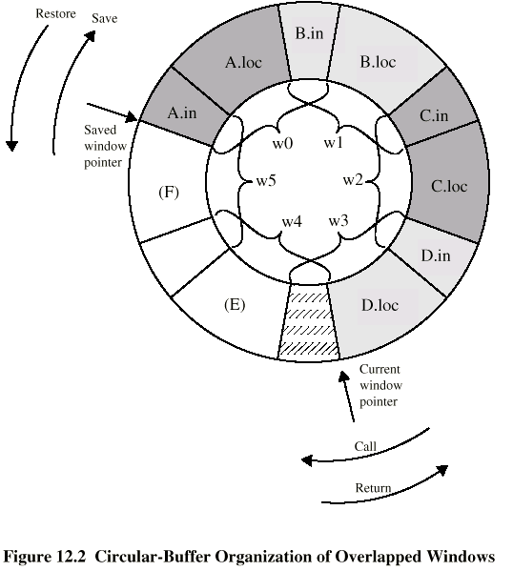
Circular Buffer diagram

Slide 14
Registers v Cache
Large Register File
Cache
All local scalars
Recently-used local scalars
Individual variables
Blocks of memory
Compiler-assigned global variables
Recently-used global variables
Save/Restore based on procedure nesting depth
Save/Restore based on cache replacement algorithm
Register addressing
Memory addressing

Slide 15
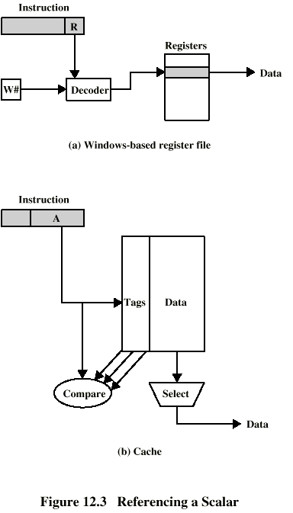
Referencing a Scalar - Window Based Register File

Slide 16
Referencing a Scalar - Cache

Slide 17
END

